Slide 1

Order Book System
Team Members
Team Memebers
VamshiKrishna
Sahithi
Sagi Uthpreksha
Sarvanthi
Shalini
Jayasreee
Mentor-Ashish Agarwal

Slide 2
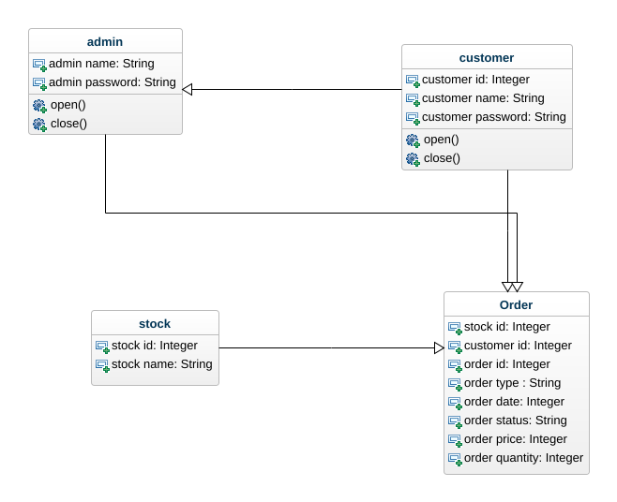
UML Daigram

Slide 3

Technologies
Front End
HTML(HYPER TEXT MARKUP LANGUAGE)
CSS(CASCADING STYLE SHEET)
Java Script
Platform used-Sublime&React

Slide 4
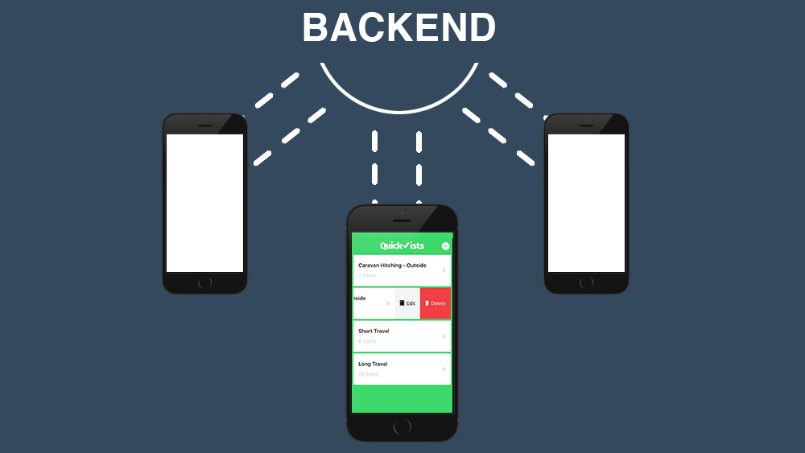
Backend
Nodejs
Expressjs
MongoDB

Slide 5
Work Flow
As per the Problem Statement
First Home page will be created with the help of home page the user or admin sign in or login into it.
Once the login or signin is done if the user is a customer he can check whether the market is open or close based on that he can place an order.
If the user is an admin he can close the market and then execute the queries which are present and get the result whether the particular order is accepted or rejected.
At the end the customer can place the order when market is open.
And the admin can execute the queries when the market is close.

Slide 6
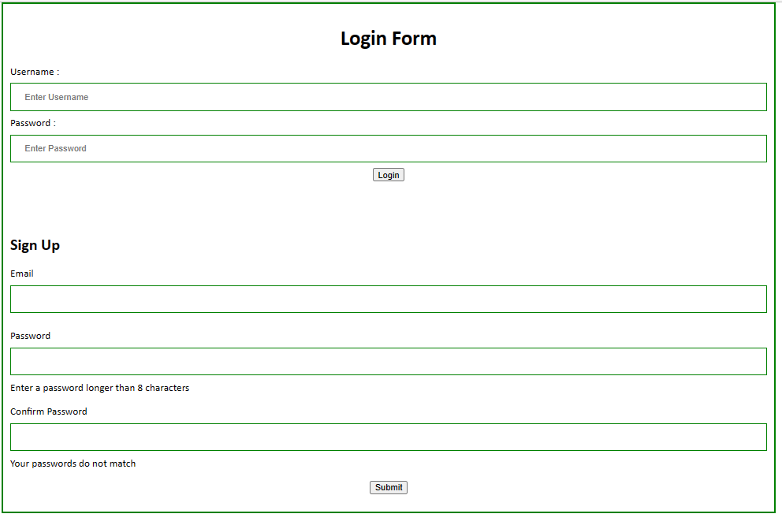

Slide 7
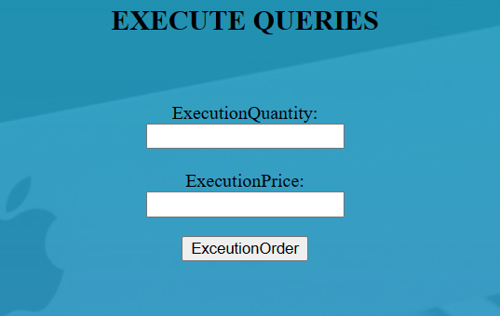
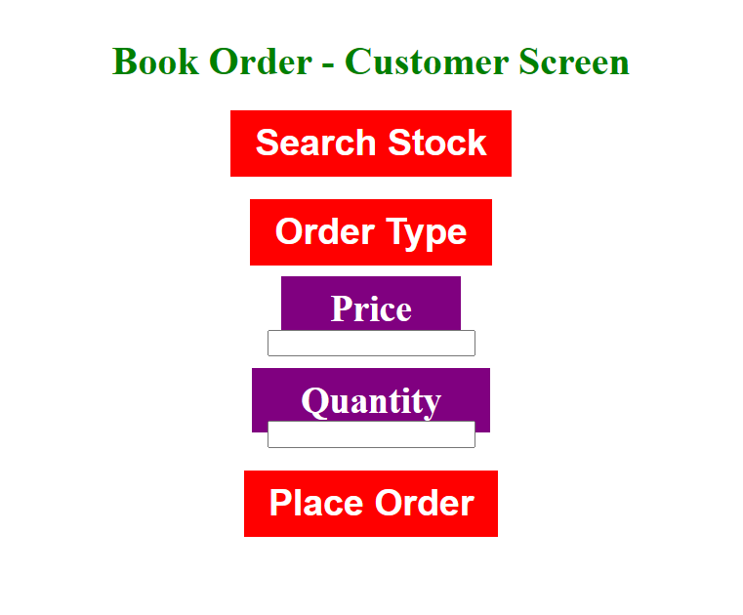
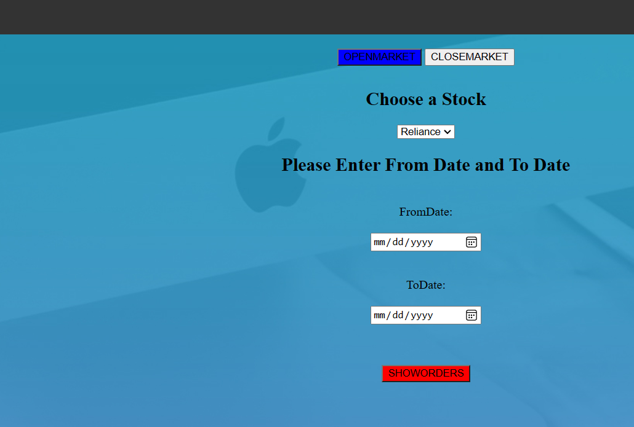

Slide 8
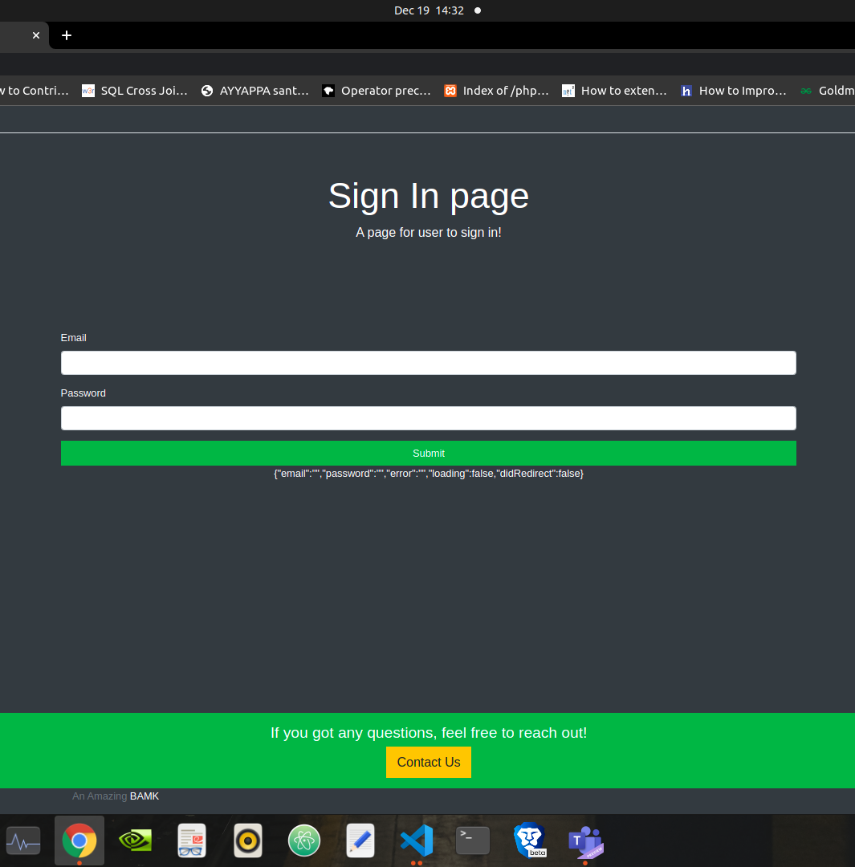
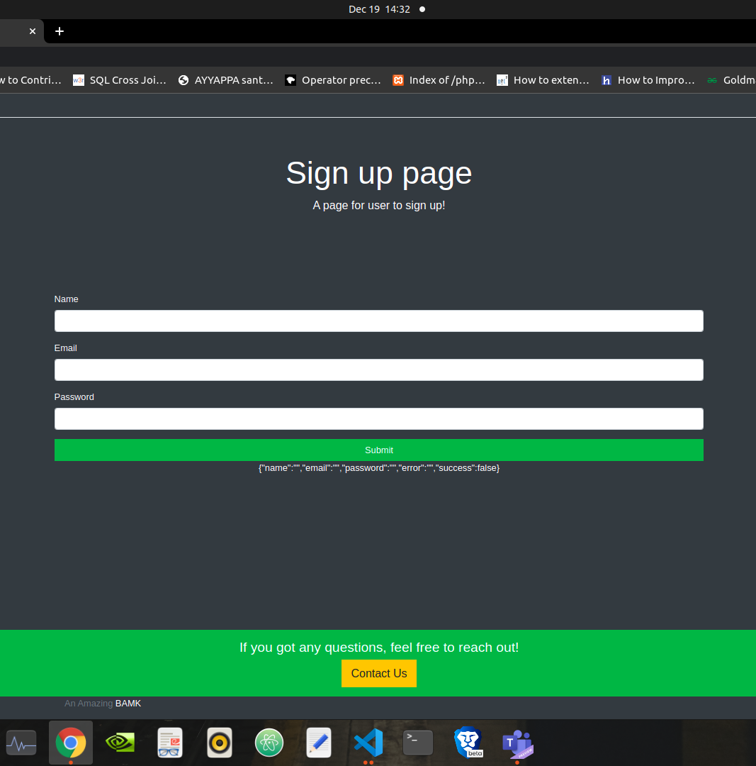

Slide 9

Thankyou

